Slide 1
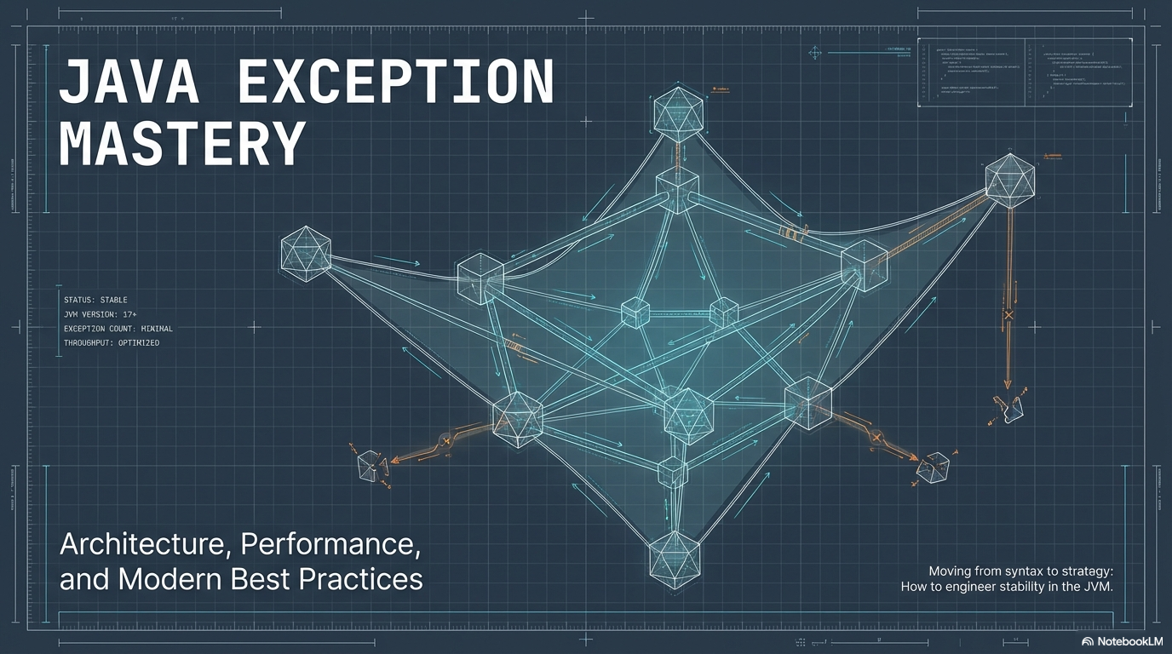


Slide 2



Advanced Programming Applications
Lecture 03- Exeption Handling
Dr. Mohamed Mostafa Eltaweel

Slide 3

Course Objectives
Understand different types of problems and problem-solving techniques.
Understand the problem-solving life cycle.
Use and understand pseudo-code and flowcharts.
Understand structured programming, functions, data types, and operators.
Understand and use different control structures.
Design and implement different solutions.
Be able to apply problem analysis and algorithmic thinking.

Slide 4
Course Contents
Revision on Conditional Statements, loops, and Arrays
Functions (Pass by value)
Pointers
Functions (Pass by Reference)
Functions (Recursion)
Strings
Structs
Searching
Sorting
Files
Problem Solving Case Studies
Course Review and Conclusion

Slide 5
Lecture Outline
Introduction
Types of Problems
Problem Solving Steps
Algorithm Design Techniques
Review Flowcharts
Review C Language
Basics (variables, data types, expressions, I/O, etc.).
Decisions (if statement and switch statement)
Loops

Slide 6

What are Exceptions?
Exception (Java): An event that occurs during program execution which disrupts the normal flow of instructions.
Java Exception Handling: A robust, object-oriented mechanism in Java used to detect, manage, and respond to runtime errors gracefully.
Common Causes of Exceptions:
Invalid user input
Hardware failures
Network connectivity issues
Database server downtime
Exception Handling Code: Specialized code that defines how the program should respond to specific error conditions to prevent crashes and maintain normal execution flow.

Slide 7
Why It Is Important
When an error occurs, the normal execution flow stops.
Without exception handling, the program terminates immediately.
With exception handling, we can define an alternative path so the program continues running or exits gracefully:
Graceful termination means:
The program does not crash unexpectedly., and resources (files, database connections, network connections) are properly closed.
A meaningful error message is shown to the user, while the remaining parts of the program can continue if possible.
Exception handling provides a structured mechanism to detect, manage, and recover from runtime errors, ensuring smoother execution and better user experience.

Slide 8
Examples of Causes of Exceptions
Invalid User Input
Example: A user enters "abc" instead of a number when the program expects an integer.
Hardware Failures
Example: Trying to read a file from a USB drive that was suddenly removed.
int age = Integer.parseInt("abc"); // Causes NumberFormatException
FileReader file = new FileReader("E:/data.txt"); // May cause FileNotFoundException

Slide 9
Examples of Causes of Exceptions
Network Connectivity Issues
Example: Trying to connect to a website without internet access.
Database Server Downtime
Example: Trying to connect to a database that is not running.
URL url = new URL("https://example.com");
URLConnection conn = url.openConnection();
conn.getInputStream(); // May cause IOException
Connection conn = DriverManager.getConnection(
"jdbc:mysql://localhost:3306/testdb", "root", "password"); // SQLException occurs

Slide 10
Throwing and Catching Exceptions
When an error occurs during execution, Java creates an exception object.
The exception object contains debugging details such as:
Exception type
Error message
Line number
Method call hierarchy (stack trace)
Creating the exception object and passing it to the runtime system is called throwing the exception.
Exception Handling Process
When an exception is thrown, the normal program flow stops.
The Java Runtime Environment (JRE) searches for a matching exception handler (catch block).
The search starts in the current method where the exception occurred.
If no handler is found, the search moves up the call stack (caller methods).
Example: If call stack is A → B → C and error occurs in C, search moves: C → B → A

Slide 11
Throwing and Catching Exceptions
public class DebugExample {
public static void main(String[] args) {
methodA();
}
static void methodA() {
methodB();
}
static void methodB() {
int result = 10 / 0; // Error occurs here
}
}
Exception in thread "main" java.lang.ArithmeticException: / by zero
at DebugExample.methodB(DebugExample.java:13)
at DebugExample.methodA(DebugExample.java:9)
at DebugExample.main(DebugExample.java:5)
Exception Type: java.lang.ArithmeticException
Error Message: / by zero
Line Number: DebugExample.java:13 (The exact line where the error occurred)
Method Call Hierarchy (Stack Trace):
methodB → methodA → main

Slide 12
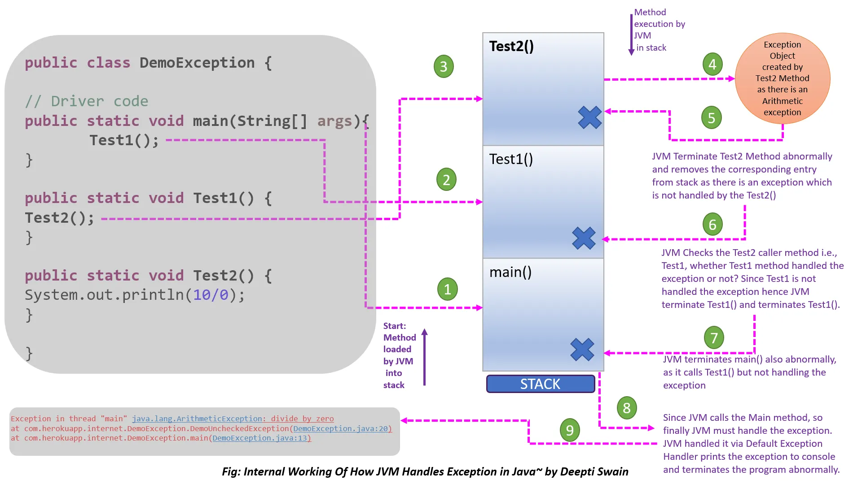
Throwing and Catching Exceptions
Source: Online

Slide 13
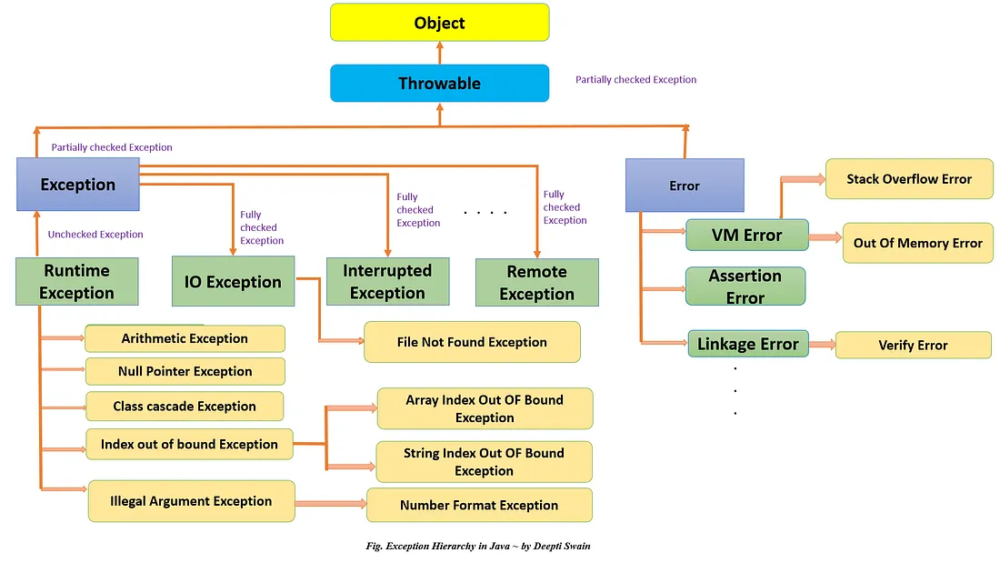
Exceptions Types
Notes:
Errors: Errors are exceptional scenarios that are out of the scope of application, and it’s not possible to anticipate and recover from them. For example, hardware failure, Java virtual machine (JVM) crash, or out-of-memory error. That’s why we have a separate hierarchy of Errors and we should not try to handle these situations. Some of the common Errors are OutOfMemoryError and StackOverflowError.

Slide 14
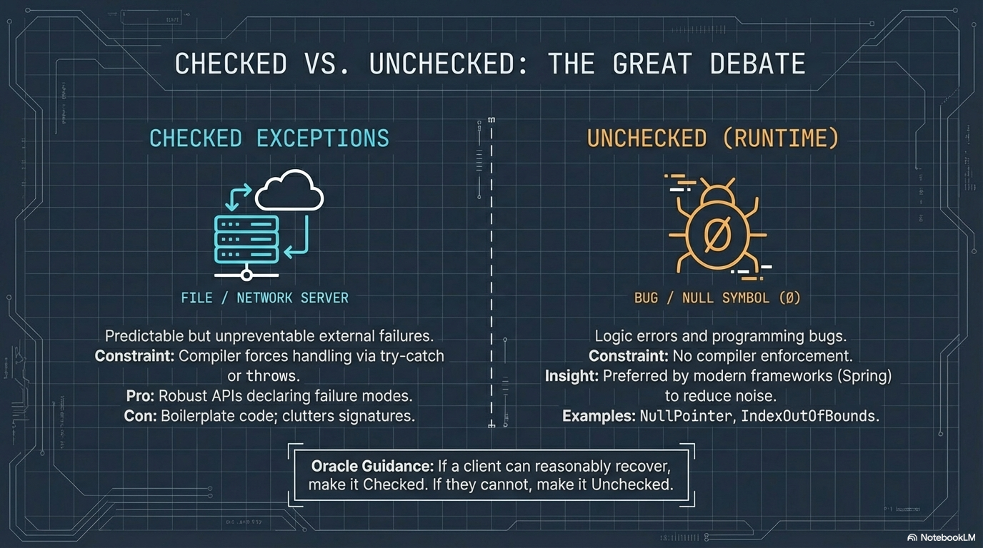
Exceptions Types
The Two Types of Exception in Java:
Notes:
Checked exceptions are enforced by the compiler, while unchecked exceptions are not.

Slide 15
Exceptions Types
Feature | Checked Exceptions | Unchecked Exceptions
Compiler Check | Checked at compile time | Not checked by compiler
Handling Requirement | Must be handled (try-catch) or declared using throws | Handling is optional
When They Occur | Occur during runtime but verified at compile time | Occur at runtime
Class Hierarchy | All exceptions except RuntimeException and Error classes | RuntimeException and its subclasses, Error and its subclasses
Purpose | Represent recoverable conditions (e.g., file, network issues) | Represent programming errors or serious problems
Examples | FileNotFoundException, InterruptedException, IOException | NullPointerException, ArithmeticException, ArrayIndexOutOfBoundsException
The Two Types of Exception in Java:
Notes:
Checked exceptions are enforced by the compiler, while unchecked exceptions are not.

Slide 16
Java Exception Handling Keywords
throw
Used to explicitly create and throw an exception in code.
Transfers control to the runtime for handling.
Commonly used for custom validations (e.g., null password, invalid input).
Example:
if (password == null) {
throw new IllegalArgumentException("Password cannot be null");
}

Slide 17
Java Exception Handling Keywords
try-catch
Used to handle exceptions.
try → contains risky code.
catch → handles the exception.
Multiple catch blocks allowed.
Can be nested.
catch parameter must be an Exception type.
Example:
try {
int x = 10 / 0;
} catch (ArithmeticException e) {
System.out.println("Cannot divide by zero");
}

Slide 18
Java Exception Handling Keywords
try-with multiple catch blocks:
Multiple catch blocks allow handling different types of exceptions separately.
Java checks the catch blocks in order and executes the first one that matches the exception type.
This is useful when a method can throw more than one kind of exception.
Example:
try {
// risky code that may throw exceptions
} catch (ExceptionType1 e) {
// handle ExceptionType1
} catch (ExceptionType2 e) {
// handle ExceptionType2
} catch (Exception e) {
// handle any other exception (optional)
}

Slide 19
Java Exception Handling Keywords
import java.io.*;
public class MultipleCatchExample {
public static void main(String[] args) {
try {
// May throw ArithmeticException
int result = 10 / 0;
// May throw ArrayIndexOutOfBoundsException
int[] numbers = {1, 2, 3};
System.out.println(numbers[5]);
} catch (ArithmeticException e) {
System.out.println("Error: Cannot divide by zero");
} catch (ArrayIndexOutOfBoundsException e) {
System.out.println("Error: Array index out of bounds");
} catch (Exception e) {
System.out.println("Error: Some other exception occurred");
}
System.out.println("Program continues normally");
}
}
try-with multiple catch blocks:
Error: Cannot divide by zero
Program continues normally

Slide 20
Java Exception Handling Keywords
throws
Declares exceptions that a method may pass to its caller.
Used in the method signature.
Allows the caller to either handle or further propagate the exception.
Can be used with the main() method.
Example:
Can declare multiple exceptions.
public void readFile() throws IOException
returnType methodName() throws ExceptionType1, ExceptionType2 {
// risky code
}

Slide 21
Examples
The Throw of multiple exceptions
import java.io.*;
public class Test {
static void readData() throws IOException, ClassNotFoundException {
FileInputStream file = new FileInputStream("data.txt"); // May throw IOException
Class.forName("com.mysql.jdbc.Driver"); // May throw ClassNotFoundException
}
public static void main(String[] args) {
try {
readData();
} catch (IOException | ClassNotFoundException e) {
System.out.println("Exception handled: " + e);
}
}
}
The catch can catch multiple exceptions in a single catch block.
Notes:
When multiple exceptions are possible inside a method, list them separated by commas in the throws clause, and the caller decides how to handle them.
Explanation
readData() declares two exceptions:
IOException
ClassNotFoundException
The method does not handle them internally.
It passes responsibility to the caller (main()).
The caller can:
Handle them using try-catch, OR
Further propagate them using throws.

Slide 22
Java Exception Handling Keywords
finally
Optional block used with try-catch.
Executes always, whether an exception occurs or not.
Commonly used for resource cleanup (closing files, database connections).
Example:
finally {
System.out.println("Cleanup code runs here");
}

Slide 23
Useful Methods of Throwable
Method | Purpose
getMessage() | Returns the exception message provided when creating the exception.
getLocalizedMessage() | Returns a locale-specific message; by default, calls getMessage().
getCause() | Returns the underlying cause of the exception, or null if unknown.
toString() | Returns a string containing the exception class name and the message.
printStackTrace() | Prints the stack trace to the standard error stream. Can also print to a PrintStream or PrintWriter for logging.
Notes:
All Java exceptions inherit from Throwable.
Exception classes categorize different error scenarios for easier handling.
Throwable implements Serializable for object interoperability.
No new methods are added in Exception subclasses; all useful methods are in Throwable.

Slide 24

Problem Solving Steps
try {
int result = 10 / 0;
} catch (ArithmeticException e) {
System.out.println("Message: " + e.getMessage());
System.out.println("Cause: " + e.getCause());
System.out.println("ToString: " + e.toString());
e.printStackTrace();
}
Message: / by zero
Cause: null
ToString: java.lang.ArithmeticException: / by zero
java.lang.ArithmeticException: / by zero
at Main.main(Main.java:3)
Notes:
These methods help identify, debug, and log exceptions efficiently, allowing programmers to handle errors gracefully.

Slide 25
A Custom Exception Class
Java provides many built-in exception classes, but sometimes custom exceptions are needed.
Purpose: Notify the caller about a specific type of error with a meaningful message or additional information.
Custom fields (like error codes) can be added to provide more context about the error.
Example scenario: A method processes only text files; if another file type is passed, a custom exception can provide an appropriate message and error code.
Notes:
Custom exceptions enhance clarity in error handling.
Can include additional data like error codes.
Helps caller methods respond appropriately to specific error scenarios.

Slide 26
A Custom Exception Class
class MyException extends Exception {
private int errorCode;
public MyException(String message, int errorCode) {
super(message);
this.errorCode = errorCode;
}
public int getErrorCode() {
return errorCode;
}
}
public class FileProcessor {
public static void processFile(String fileName) throws MyException {
if (!fileName.endsWith(".txt")) {
throw new MyException("Only text files are allowed", 101);
}
System.out.println("Processing file: " + fileName);
}
public static void main(String[] args) {
try {
processFile("data.pdf");
} catch (MyException e) {
System.out.println("Error: " + e.getMessage() + " | Code: " + e.getErrorCode());
} }
}
Error: Only text files are allowed | Code: 101
Notes:
Custom exceptions enhance clarity in error handling.
Can include additional data like error codes.
Helps caller methods respond appropriately to specific error scenarios.

Slide 27
Assignment
Write a Java program that performs operations on an integer array. The program should handle multiple types of exceptions gracefully.
Requirements
Ask the user to input the size of the array and its elements.
Then ask the user for an index to retrieve an element.
If the user enters an invalid index, handle ArrayIndexOutOfBoundsException.
Ask the user to input two integers to divide.
Handle ArithmeticException if the second number is zero.
Create a custom exception NegativeArraySizeException if the user enters a negative array size, and display a meaningful message and error code.
Use multiple catch blocks.
Include a finally block to print "Program completed" regardless of exceptions.
Use methods for array input and division, and propagate exceptions using throws where appropriate.
Notes:
import java.util.Scanner;
// Custom exception for negative array size
class NegativeArraySizeCustomException extends Exception {
private int errorCode;
public NegativeArraySizeCustomException(String message, int errorCode) {
super(message);
this.errorCode = errorCode;
}
public int getErrorCode() {
return errorCode;
}
}
public class ArrayOperations {
// Method to read array elements
public static int[] readArray(int size) throws NegativeArraySizeCustomException {
if (size < 0) {
throw new NegativeArraySizeCustomException("Array size cannot be negative", 101);
}
Scanner sc = new Scanner(System.in);
int[] arr = new int[size];
System.out.print("Enter elements: ");
for (int i = 0; i < size; i++) {
arr[i] = sc.nextInt();
}
return arr;
}
// Method to get an element at given index
public static int getElement(int[] arr, int index) {
return arr[index]; // May throw ArrayIndexOutOfBoundsException
}
// Method to divide two numbers
public static int divide(int a, int b) {
return a / b; // May throw ArithmeticException
}
public static void main(String[] args) {
Scanner sc = new Scanner(System.in);
try {
// Array input
System.out.print("Enter array size: ");
int size = sc.nextInt();
int[] arr = readArray(size);
// Access element by index
System.out.print("Enter index to access: ");
int index = sc.nextInt();
System.out.println("Element at index " + index + ": " + getElement(arr, index));
// Division operation
System.out.print("Enter first number: ");
int num1 = sc.nextInt();
System.out.print("Enter second number: ");
int num2 = sc.nextInt();
System.out.println("Result: " + divide(num1, num2));
} catch (NegativeArraySizeCustomException e) {
System.out.println("Error: " + e.getMessage() + " | Code: " + e.getErrorCode());
} catch (ArrayIndexOutOfBoundsException e) {
System.out.println("Error: Index out of bounds. Valid indices are 0 to " + (e.getMessage()));
} catch (ArithmeticException e) {
System.out.println("Error: Cannot divide by zero");
} catch (Exception e) {
System.out.println("Some other exception occurred: " + e);
} finally {
System.out.println("Program completed.");
}
}
}

Slide 28

Thank you

